Slide 1


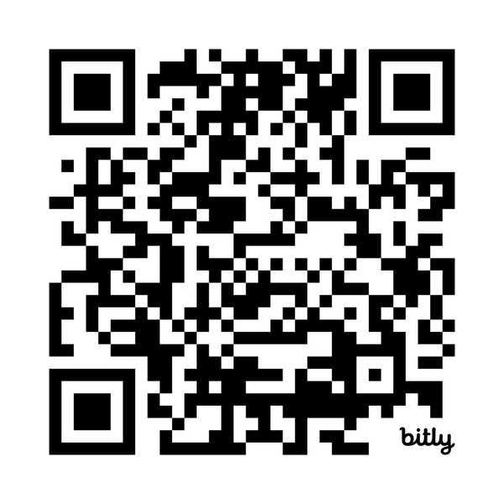
Wondering How to Start Your Job Search?
Master’s Career Training Platform
Starting a job search can feel overwhelming. But as a master's student, you already have access to Beyond Graduate School — a career training platform built for exactly this moment. Log in to access on-demand videos, workbooks, and live webinars with the information you need to navigate a competitive job market.
Log in to get started at:
institutions.beyondgradschool.com

Slide 2


August 19, 2026 (2:00 - 2:30pm ET): Why Master’s Students Should Plan on a 9 Month Job Search
September 2, 2026 (2:00 - 2:30pm ET): How Master's Students Can Make the Most of Career Fairs
September 14 - 18, 2026 (2:00 - 2:30pm ET): Don't Wait: What New Master's Students Need to Know About Finding a Job
  September 14: 3 mistakes master's students must avoid in their job search
  September 15: The role of recruiters in the hiring process
  September 16: How to build a network when you don't have one
  September 17: Strategic resume writing for master's students
  September 18: Career advice for international students job searching in the US
October 7, 2026 (2:00 - 2:30pm ET): AI Skills Employers are Looking For in Master's Students
October 21, 2026 (2:00 - 2:30pm ET): 3 Mistakes Master's Students Make on LinkedIn
November 4, 2026 (2:00 - 2:30pm ET): How to Stand Out in an AI-Driven Job Market
November 18, 2026 (2:00 - 2:30pm ET): What International Students Need to Know About Job Searching in Canada and the US
December 14 - 17, 2026 (2:00 - 2:30pm ET): Your Next Career Move: Strategies for Career Changers and Career Advancers
© The Center for Graduate Career Success

