Slide 1


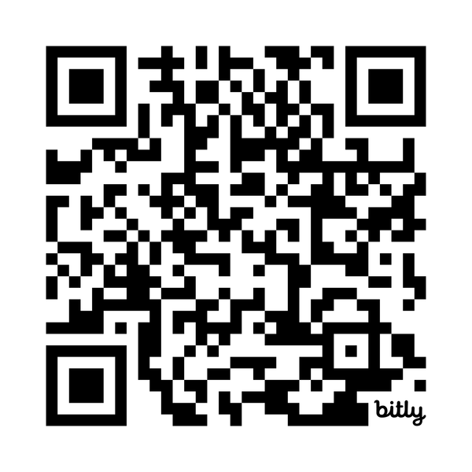
What Can You Do With Your PhD?
PhD Career Training Platform
You have more options than you think. And as a doctoral student or postdoc, you can explore these options through Beyond the Professoriate — a platform you already have access to. Log in to access on-demand videos, workbooks, and live webinars that will help you build a career in academia or beyond.
Log in to get started at:
institutions.beyondprof.com

Slide 2

August 24 - 28, 2026 (12:00 – 12:45 pm ET): Academic Job Market Boot Camp
September 2, 2026 (12:00 – 12:45 pm ET): How to Use the PhD Career Training Platform in Your Job Search
September 16, 2026 (12:00 – 12:45 pm ET): Is a Faculty Job Right for You?
October 7, 2026 (12:00 – 12:45 pm ET): The Key Difference Between Academic and Nonacademic Hiring — and What It Means for Your Job Search
October 21, 2026 (12:00 – 12:45 pm ET): Going Beyond Subject Matter: How to Identify Skills Employers Want
November 4, 2026 (12:00 – 12:45 pm ET): How to Research Career Options in Industry
November 18, 2026 (12:00 – 12:45 pm ET): Building a Network to Help You in Academia and Beyond
December 7- 10, 2026 (12:00 – 12:45 pm ET): How to Decide Between an Academic and Nonacademic Career
  Prerecorded: How to decide and what you will need to consider
  December 7: How to identify your values
  December 8: How to identify your most marketable skills
  December 9: How to build your network using on-campus resources
  December 10: Practical considerations and your decision rubric
© The Center for Graduate Career Success

