Slide 1


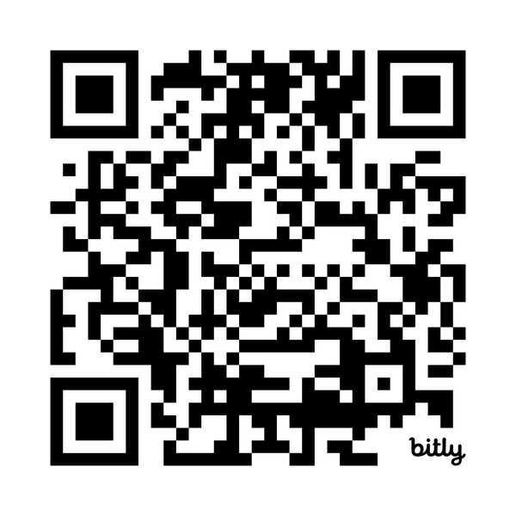
Wondering How to Start Your Job Search?
Master’s Career Training Platform
Starting a job search can feel overwhelming. But as a master's student, you already have access to Beyond Graduate School — a career training platform built for exactly this moment. Log in to access on-demand videos, workbooks, and live webinars with the information you need to navigate a competitive job market.
Log in to get started at:
institutions.beyondgradschool.com

