Slide 1


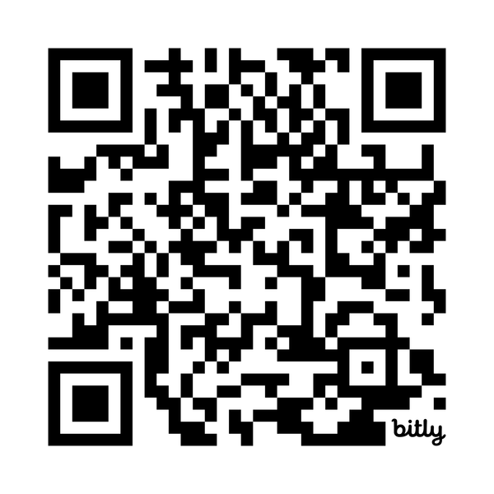
What Can You Do With Your PhD?
PhD Career Training Platform
You have more options than you think. And as a doctoral student or postdoc, you can explore these options through Beyond the Professoriate — a platform you already have access to. Log in to access on-demand videos, workbooks, and live webinars that will help you build a career in academia or beyond.
Log in to get started at:
institutions.beyondprof.com

