Slide 1



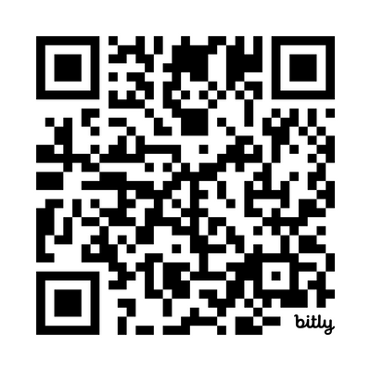
PHD CAREER TRAINING PLATFORM
Where PhDs learn how to build careers in academia and beyond. Explore your career options today.
View upcoming events and register to attend at:
https://institutions.beyondgradschool.com/events-and-trainings/

Slide 2

PHD CAREER TRAINING PLATFORM
Where PhDs learn how to build careers in academia and beyond. Explore your career options today.
View upcoming events and register to attend at:
https://institutions.beyondgradschool.com/events-and-trainings/

